Slide 1

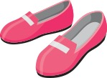

Nuair a bhios mi aig partaidh…
Bidh dreasa snog orm.
Bidh stocainnean geala orm.
Bidh brògan gleansach orm.
Notes:
When I’m at a party…
I wear a nice dress.
I wear white socks.
I wear shiny shoes.

Slide 2
Nuair a bhios mi aig an tràigh…
Bidh briogais ghoirid orm.
Bidh lèine-t orm.
Bidh speuclairean dubha orm.
Notes:
When I’m at the beach…
I wear shorts.
I wear a t-shirt.
I wear sun glasses.

Slide 3
Nuair a bhios mi a’ gabhail cuairt…
Bidh seacaid bhlàth orm.
Bidh bòtannan dearg orm.
Bidh ad bhlàth orm.
Notes:
When I go for a walk…
I wear a warm coat.
I wear red boots.
I wear a colourful hat.

Slide 4
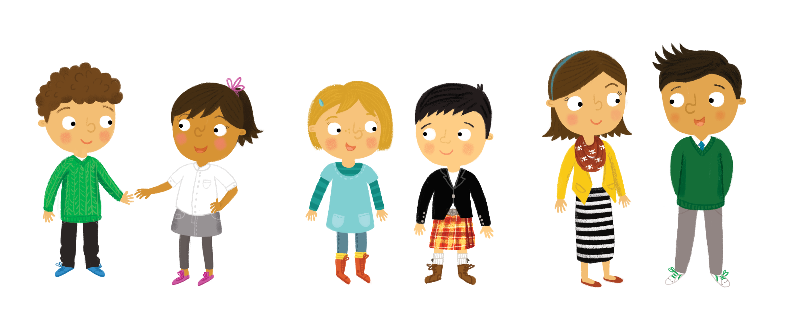
Nuair a bhios mi aig banais…
Bidh seacaid dhubh orm.
Bidh fèileadh spaideil orm.
Bidh brògan donn orm.
Notes:
When I’m at a wedding…
I wear a black jacket.
I wear a smart kilt.
I wear brown shoes.

Slide 5
Dè an t-aodach a bhios ortsa
nuair a bhios tusa aig partaidh, no aig an tràigh,
no anns a’ phàirc no aig
banais?
Notes:
What clothes do YOU wear
when YOU’re at a party,
or at the beach, or at the park or at
a wedding?

